Slide 1


Lung Cancer Survival Analysis
MGMT 672 - ADVANCED BUSINESS ANALYTICS
Presented By – Team 4

Slide 2







Team 4 – Section 3
Aman Bhargava
Jay Lee
Mansha Kalra
Rajas Kapure
Sree Kailash Ravichandar
Yen Tsz Huang
Zainab Aljaroudi

Slide 3
01
02
DATA & EDA
BUSINESS QUESTIONS
03
04
METHODOLOGY
RECOMMENDATIONS
Table of Contents

Slide 4




Lung Cancer Data
Features
Dependent Variable
Analysis Techniques
Data Level Aggregation
Patient-level
records
Status:
1 – Censored
2 – Not alive
1. Imputation – CART
2. Kaplan-Meier Plot
3. Cox Proportional Hazards Model
Institution
Survival Time
ECOG Perf.
Age
Karnofsky Perf.
Sex
Calorie
Weight Loss

Slide 5


Descriptive Analysis
39 - 44
45 - 49
50 - 54
55 - 59
60 - 65
66 - 70
71 - 75
76 - 80
80 - 85
Death Portion
39%
61%
228 Records
165 Death
72%

Slide 6
Business Questions
What variables are significant to the patient’s survival?
Which gender is more affected to Lung Cancer?
Which age bracket of patients is severely prone to Lung Cancer?
How crucial is the ECOG performance score w.r.t the level of severity?
How indicative are the Karnofsky values w.r.t the level of severity?
How is weight loss related to the level of severity?
Business Use Case: An assistive tool to Medical Professionals

Slide 7
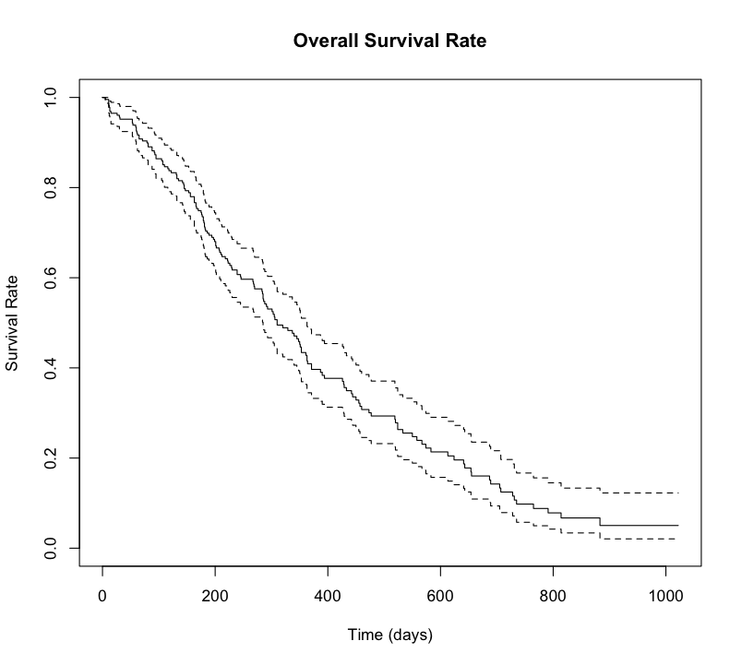
Overall Survival Rate
Survival Rate in 1st Year
41%
Survival Rate in 2nd Year
11%
Notes:
Lung Cancer criticality.

Slide 8






What variables are significant to the patient’s survival?
Sex
Age
ECOG Performance
Weight Loss
Karnofsky Performance
Cox Model

Slide 9
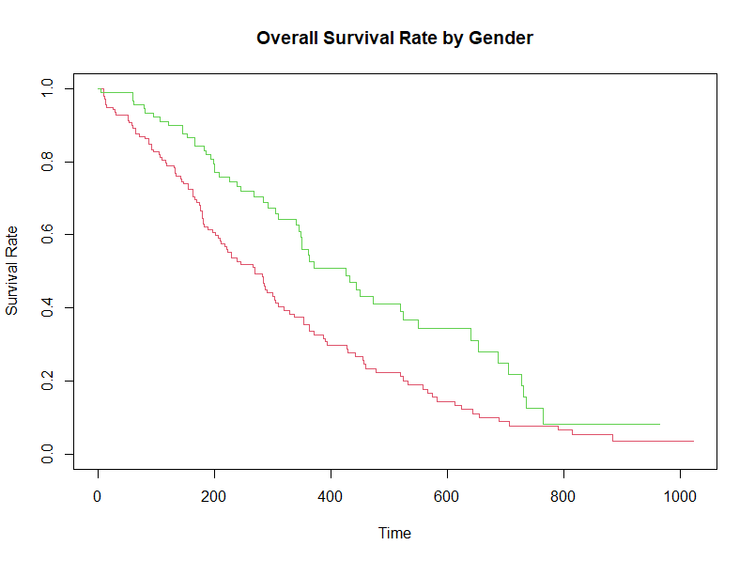

What Gender Is More Affected?
Female
45% Less risk
than male
Last 1.5 mo. of 1st Year
Year 1
Female: 52.7%
Male: 33.6%
Last 3 mo. of 2nd Year
45%
Female
Year 2
Female: 15.6%
Male: 7.3%
Male

Slide 10
Which age bracket of patients is prone to Lung Cancer?
How is weight loss related to the level of severity?
People > 70 years of age
For 1 unit increase in weight loss, there is a 2% decrease in chance of succumbing to the disease
Have a 60% higher chance of succumbing to cancer than people below 50 years.
60%
2%
Confidence interval of 88%
Confidence interval of 93%

Slide 11
ECOG Scale
Standard
ECOG Performance Status Scale
Describes a patient’s level of functioning in terms of their ability to care for themselves, daily activity, and physical ability.
0 Fully Active
1 Able to Carry Light Work
2 Unable to Work but in bed < 50%
3 Unable to Work, in bed > 50%

Slide 12
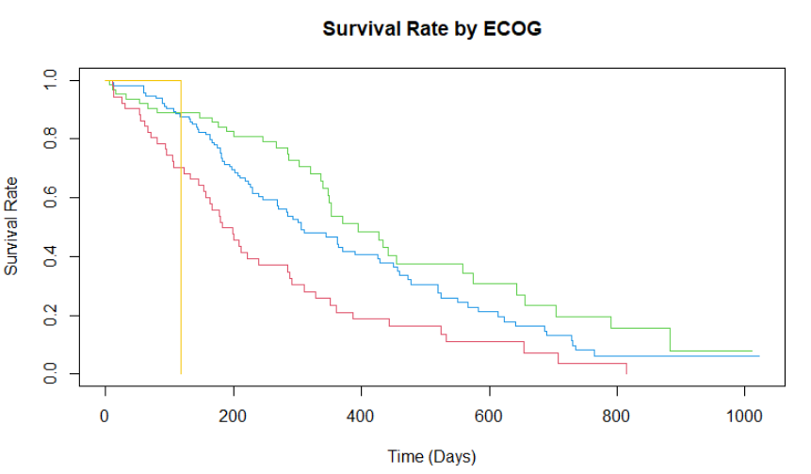
Survival Analysis by ECOG Scale
ECOG 0 Survival Rate in 1st Year
51%
ECOG 1 Survival Rate in 1st Year
43%
ECOG 2 Survival Rate in 1st Year
ECOG3
21%

Slide 13
How crucial is the ECOG performance score w.r.t the level of severity?
Hazard Ratio : 1.9
Risk of Death: 90% more than ECOG 0
ECOG 1
Hazard Ratio : 3.62
Risk of Death : 262% more than ECOG 0
ECOG 2
Hazard Ratio : 11.62
Risk of Death : 1062% more than ECOG 0
ECOG3

Slide 14
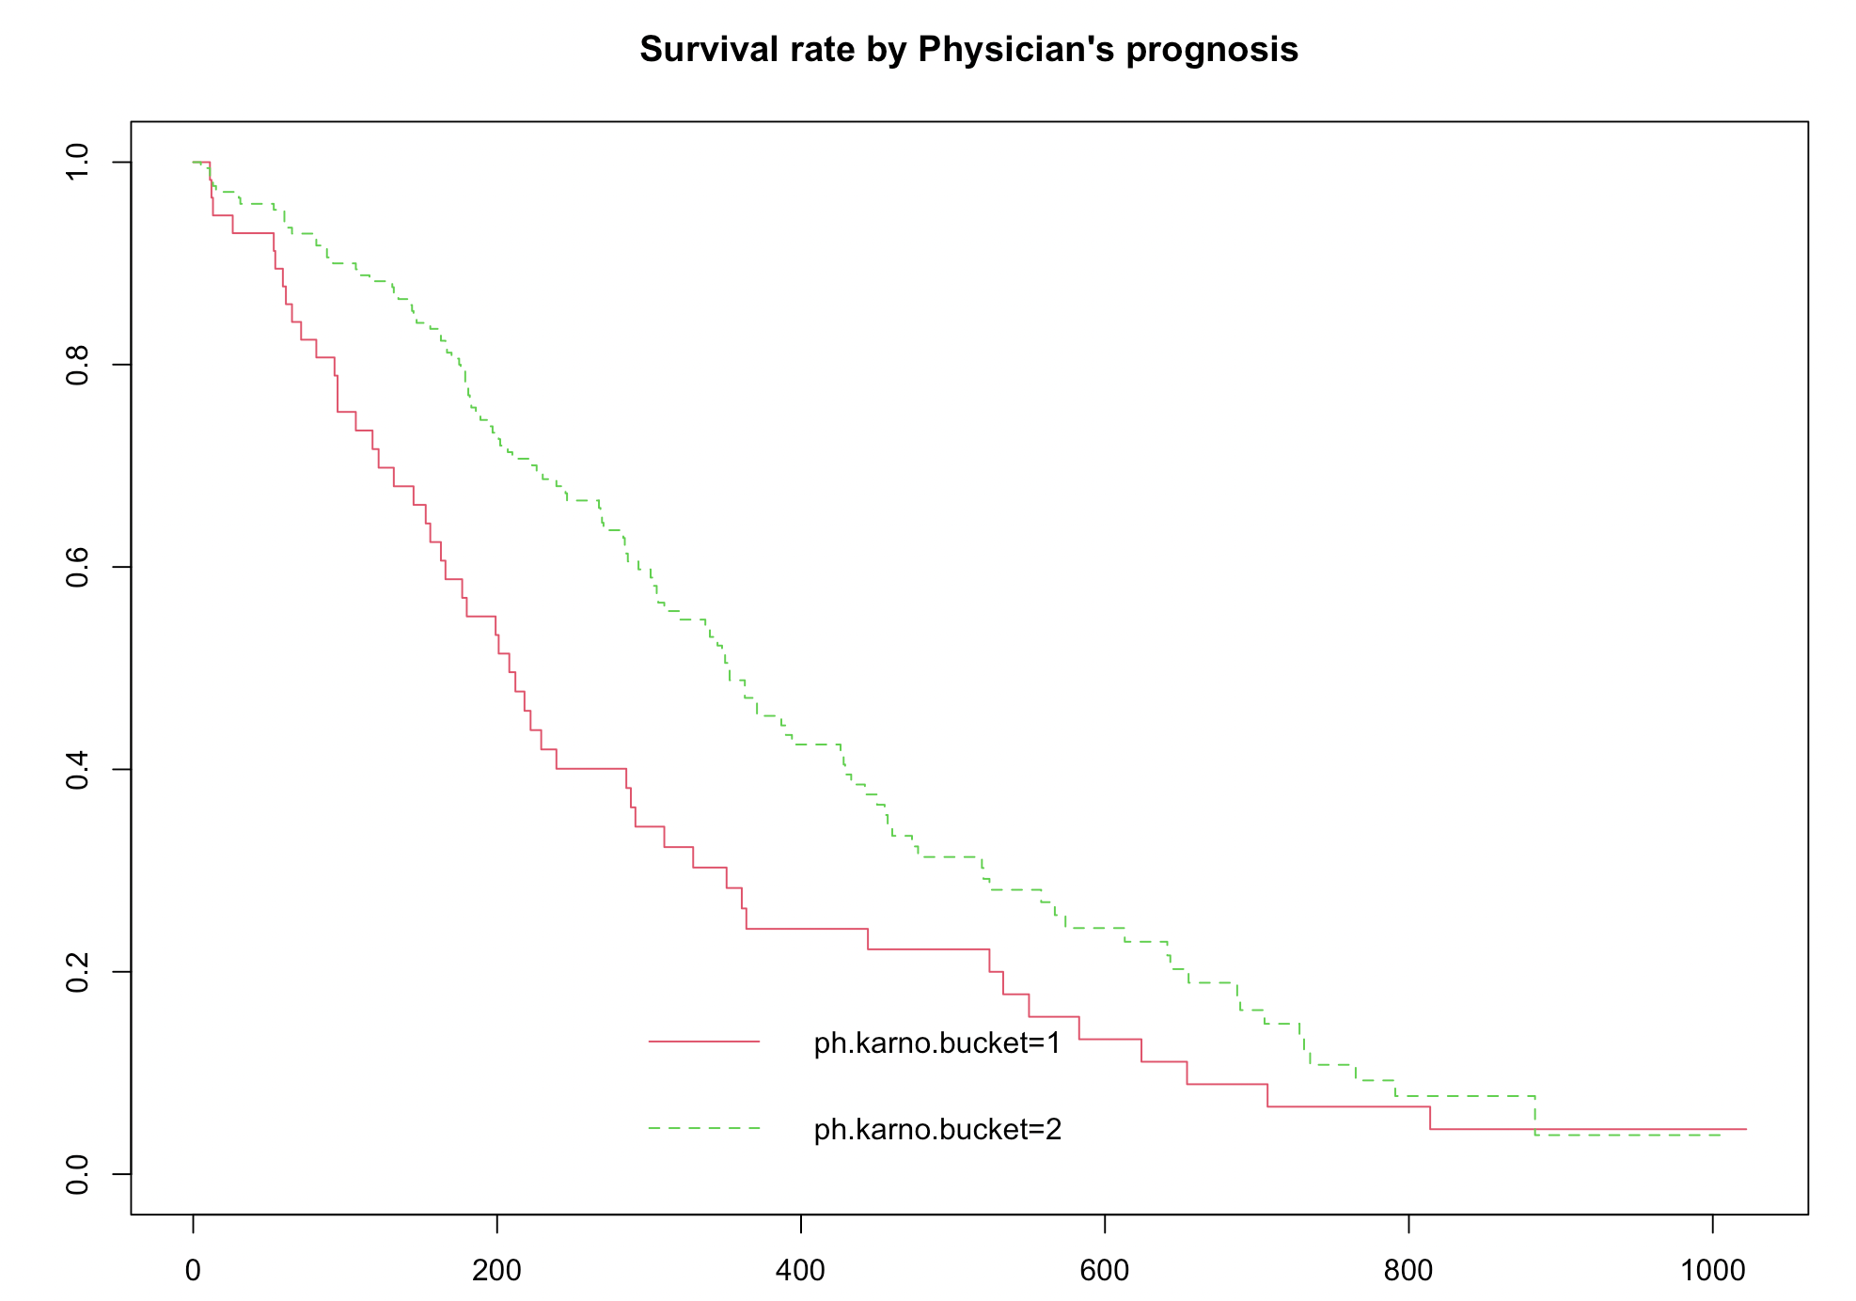
What does the Physician’s prognosis score indicate?
0
Bucket 0
Unable to care for self; Complete assistance
Survival Rate in 1st Year
48%
40
Survival Rate in 1st Year
Bucket 1
Bucket 1
25%
Unable to work but able to care for self;
Some assistance required
Bucket 2
70
Bucket 2
Able to carry on normal activity; no assistance required
100
But is physician’s karnofksy score significant in modeling risk rate in the presence of other variables? No
http://www.npcrc.org/files/news/karnofsky_performance_scale.pdf

Slide 15
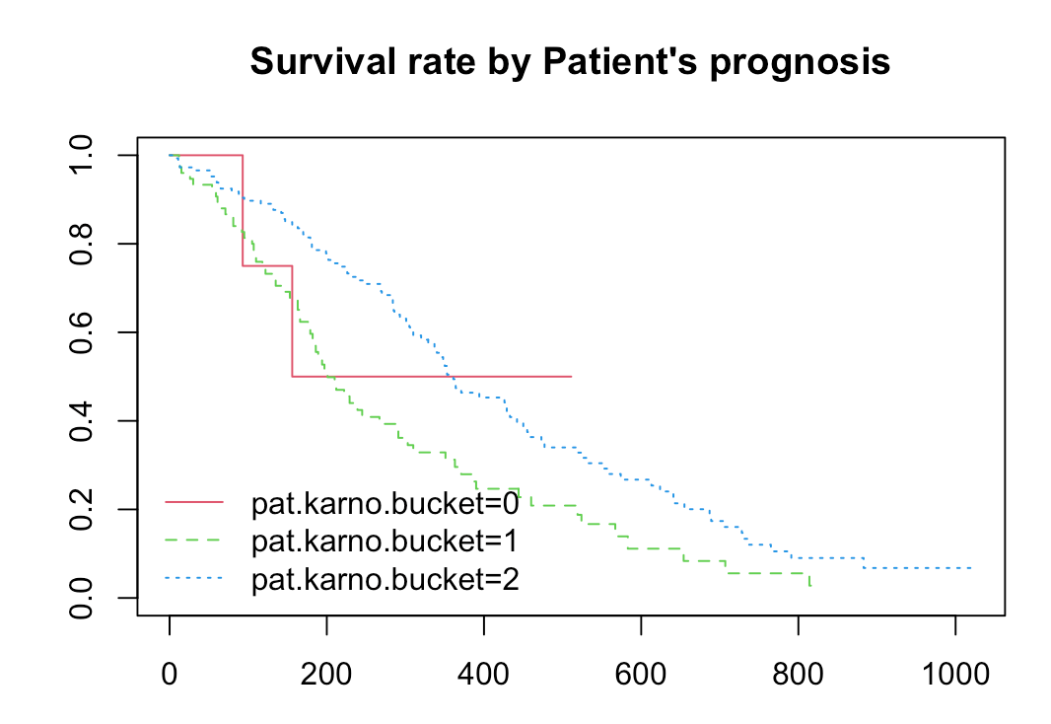
What does the Patient’s prognosis score indicate?
Bucket 0
Bucket 2
Bucket 1
Patient Karnofsky bucket is not significant in modeling risk too!
Bucket 0 - 70-100 : Complete assistance required
Bucket 1 - 40-70 : Some assistance required
Bucket 2 - 0-40 : Normal

Slide 16
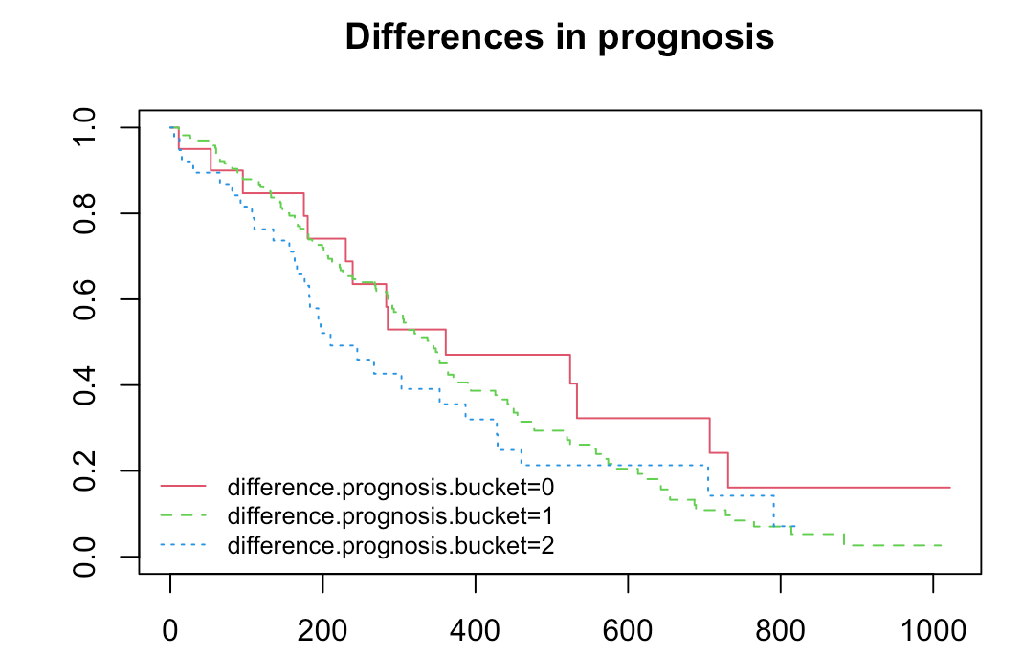
But what if there are differences in prognosis?
Difference between Physician’s karnofksy score and Patient’s karnofksy score
0 – Patient feels he is healthier
1 – Physician and Patient are on the same page
2 – Patient feels he is sicker
Patient who feels sicker has a 64% higher risk of death in comparison to a patient who concur with physician’s prognosis.
Patient who feels healthier has a 102% lower risk of death in comparison to a patient who concur with physician’s prognosis.
Bucket 0
Bucket 2
Bucket 1
64%
102%

Slide 17


Recommendations
Re-evaluate Physician Karnofsky score for patients believing they score higher
Re-assess Diagnosis
Partner with health fitness companies to better track calorie intake and weight loss
Fitness app partnership
Usage of additional metrics such as QOL (Quality of Life), BMI (Body Mass Index)
Sophisticated Monitoring

Slide 18
Thank You
- Team 4

Slide 19
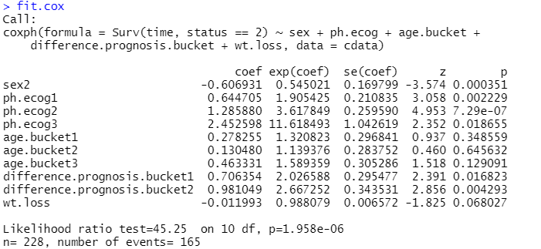
Cox Model

